Slide 1
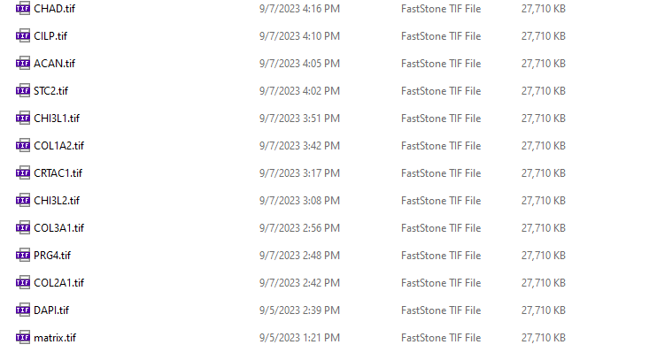
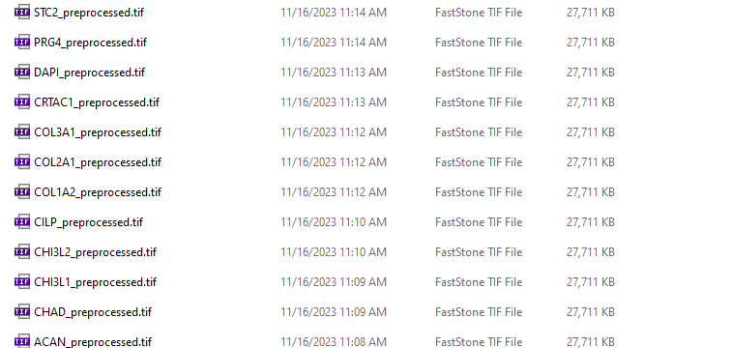
RAW
Preprocessed
Thresholding, Adjust contrast, brightness, level, etc. (HW code)
ACAN
ACAN_preprocessed

Slide 2
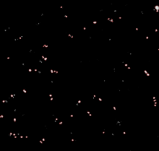
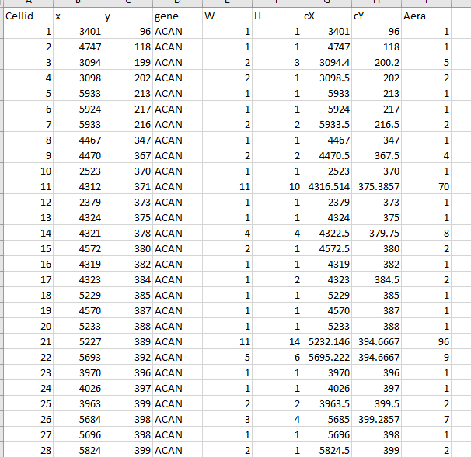
ACAN_preprocessed
ACAN_Identified
Threshold of the image spot area;
Quantified location and area, etc.

Slide 3
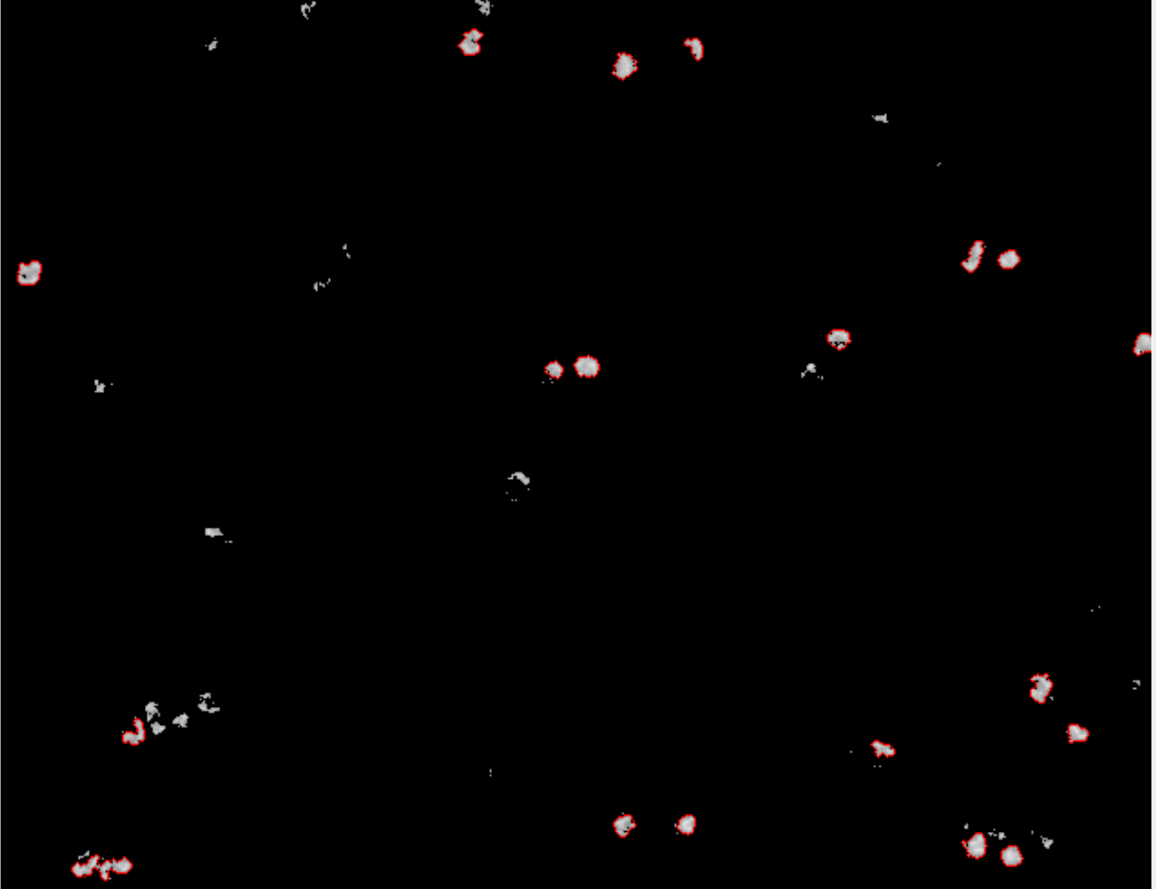
Shortage of the area size thresholding: some spots are not picked up

Slide 4
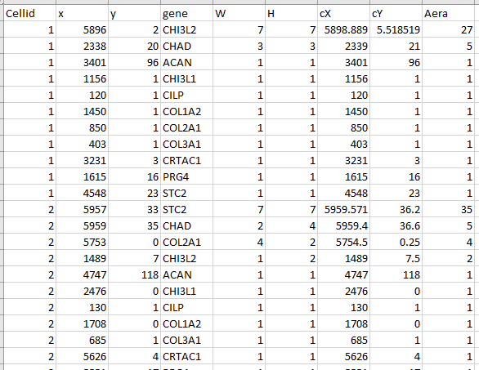
gene_identifided.csv
CILP
COL2A1
COL3A1
COL1A2
CHAD
CHI3L2
CRTAC1
STC2
PRG4
CHI3L1
ACAN
Combined

Slide 5
DAPI_preprocessed.tif

Slide 6
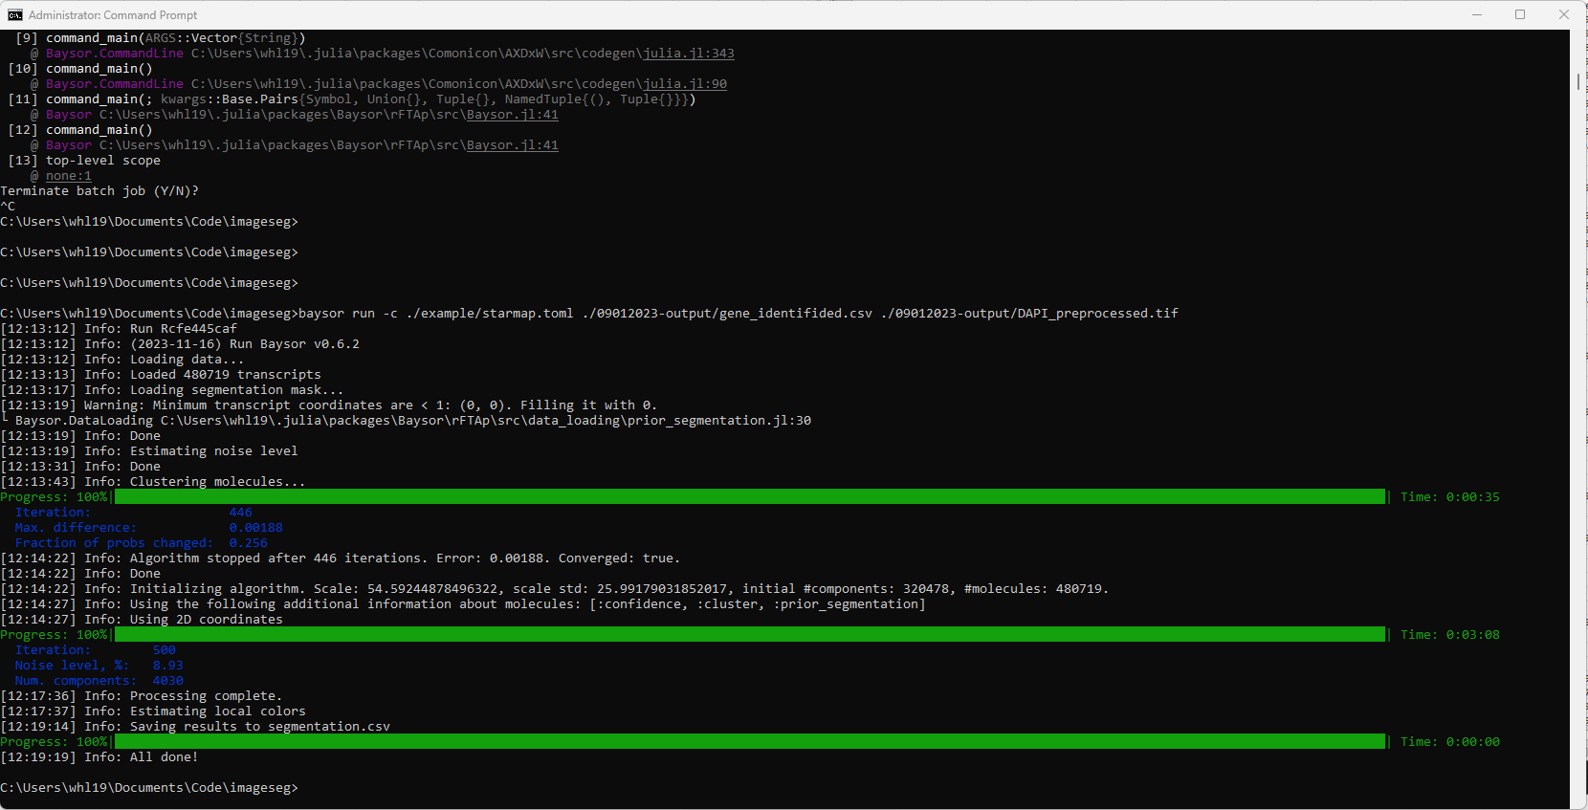
baysor run -c ./example/starmap.toml ./09012023-output/gene_identifided.csv ./09012023-output/DAPI_preprocessed.tif

Slide 7
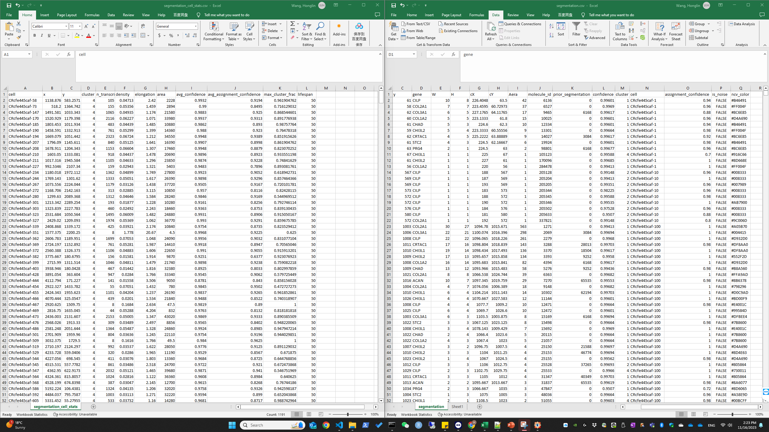

Slide 8
Preprocessing
Gene spot identification
Gene spot quantification
Post processing based on cell location
Baysor
Out come
Preprocessed DAPI image
(Cell boundary)
Interpretation
?

Slide 9
x | y | gene | W | H | cX | cY | Gene Aera | molecule_id | prior_segmentation | confidence | cluster | cell
223 | 61 | CILP | 10 | 8 | 226.4048 | 63.5 | 42 | 6136 | 0 | 0.99601 | 1 | CRcfe445caf-1
221 | 58 | COL2A1 | 7 | 7 | 223.4595 | 60.72973 | 37 | 6527 | 0 | 0.9969 | 1 | CRcfe445caf-1
225 | 62 | COL3A1 | 6 | 5 | 227.1765 | 64.11765 | 17 | 9465 | 6168 | 0.99617 | 1 | CRcfe445caf-1
221 | 60 | COL1A2 | 5 | 5 | 223.1333 | 61.8 | 15 | 10025 | 0 | 0.99601 | 1 | CRcfe445caf-1
222 | 61 | CHAD | 5 | 3 | 224.6 | 62.3 | 10 | 12334 | 0 | 0.99601 | 1 | CRcfe445caf-1
221 | 59 | CHI3L2 | 5 | 4 | 223.3333 | 60.55556 | 9 | 13301 | 0 | 0.99664 | 1 | CRcfe445caf-1
224 | 62 | CRTAC1 | 4 | 5 | 225.2222 | 63.88889 | 9 | 14027 | 3084 | 0.99617 | 1 | CRcfe445caf-1
223 | 61 | STC2 | 4 | 3 | 224.5 | 62.16667 | 6 | 19924 | 0 | 0.99601 | 1 | CRcfe445caf-1
224 | 63 | PRG4 | 2 | 1 | 224.5 | 63 | 2 | 98801 | 6168 | 0.99677 | 1 | CRcfe445caf-1
225 | 67 | CHI3L1 | 1 | 1 | 225 | 67 | 1 | 105123 | 0 | 0.99588 | 4 | CRcfe445caf-1
227 | 61 | CHI3L2 | 1 | 1 | 227 | 61 | 1 | 170096 | 0 | 0.99685 | 1 | CRcfe445caf-1
220 | 56 | COL1A2 | 1 | 1 | 220 | 56 | 1 | 284478 | 0 | 0.99413 | 1 | CRcfe445caf-1
CRcfe445caf-1

Slide 10
CLIP
COL2A1
x | y | gene | W | H | cX | cY | Gene Aera | molecule_id | prior_segmentation | confidence | cluster | cell
188 | 567 | CILP | 1 | 1 | 188 | 567 | 1 | 205128 | 0 | 0.99148 | 2 | CRcfe445caf-10
187 | 569 | CILP | 1 | 1 | 187 | 569 | 1 | 205204 | 0 | 0.99413 | 2 | CRcfe445caf-10
193 | 569 | CILP | 1 | 1 | 193 | 569 | 1 | 205205 | 0 | 0.99351 | 2 | CRcfe445caf-10
183 | 573 | CILP | 1 | 1 | 183 | 573 | 1 | 205344 | 0 | 0.98225 | 2 | CRcfe445caf-10
188 | 572 | CILP | 1 | 1 | 188 | 572 | 1 | 205345 | 0 | 0.99588 | 2 | CRcfe445caf-10
190 | 572 | CILP | 1 | 1 | 190 | 572 | 1 | 205346 | 0 | 0.99535 | 2 | CRcfe445caf-10
184 | 576 | CILP | 1 | 1 | 184 | 576 | 1 | 205502 | 0 | 0.97528 | 2 | CRcfe445caf-10
181 | 580 | CILP | 1 | 1 | 181 | 580 | 1 | 205633 | 0 | 0.9507 | 2 | CRcfe445caf-10
192 | 572 | COL2A1 | 1 | 1 | 192 | 572 | 1 | 337821 | 0 | 0.99148 | 2 | CRcfe445caf-10
CRcfe445caf-10

Slide 11
How many cells highly (z score > 0) expressing all 11 genes in CN4?
Which other genes are highly expressing in this type of cell?

